Slide 1
Metallic Intralenticular foreign body: A case presentation
Presenter: Ouk Sok Hean

Slide 2
Case presentation
  A 50 year-old healthy man, with no previous ocular history, presented on Wednesday 18th, June, with
  Tearing,
  FB sensation, and
  Blurred vision
  Photophobia
He noticed the symptoms after hammering metal on metal one day back.

Slide 3
Examination
  VA RE 6/6. RE is normal.
  VA LE 6/36 pinhole 6/24
    Lid: normal
    Conjunctiva: injection
    Cornea: central 2mm self-sealed full thickness lacerated wound. Siedel test (-)
    AC: deep, cell +, no fibrin, no hypopyon
    Iris: normal & good pupillary reaction
    Lens: Anterior capsule ruptured with cataract formation. A piece of foreign body is found, after pupillary dilation, in inferior lens
    Ocular motility: normal
    Fundus: normal

Slide 4
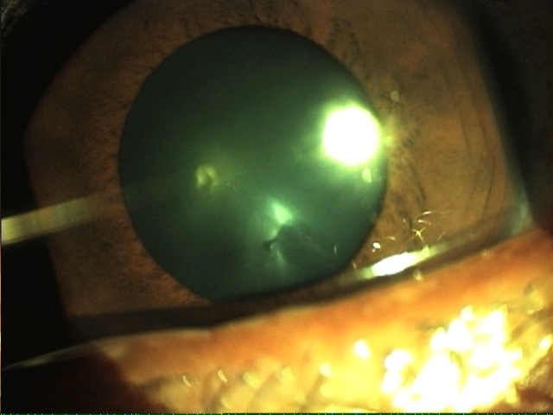
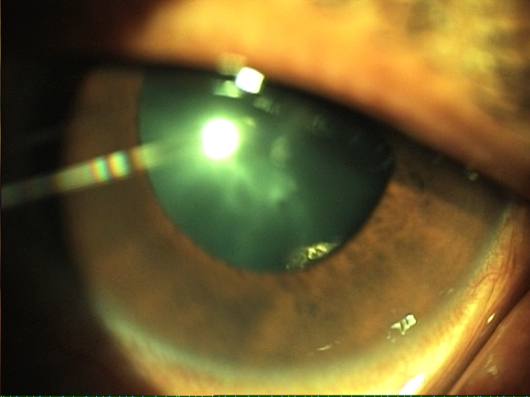

Slide 5
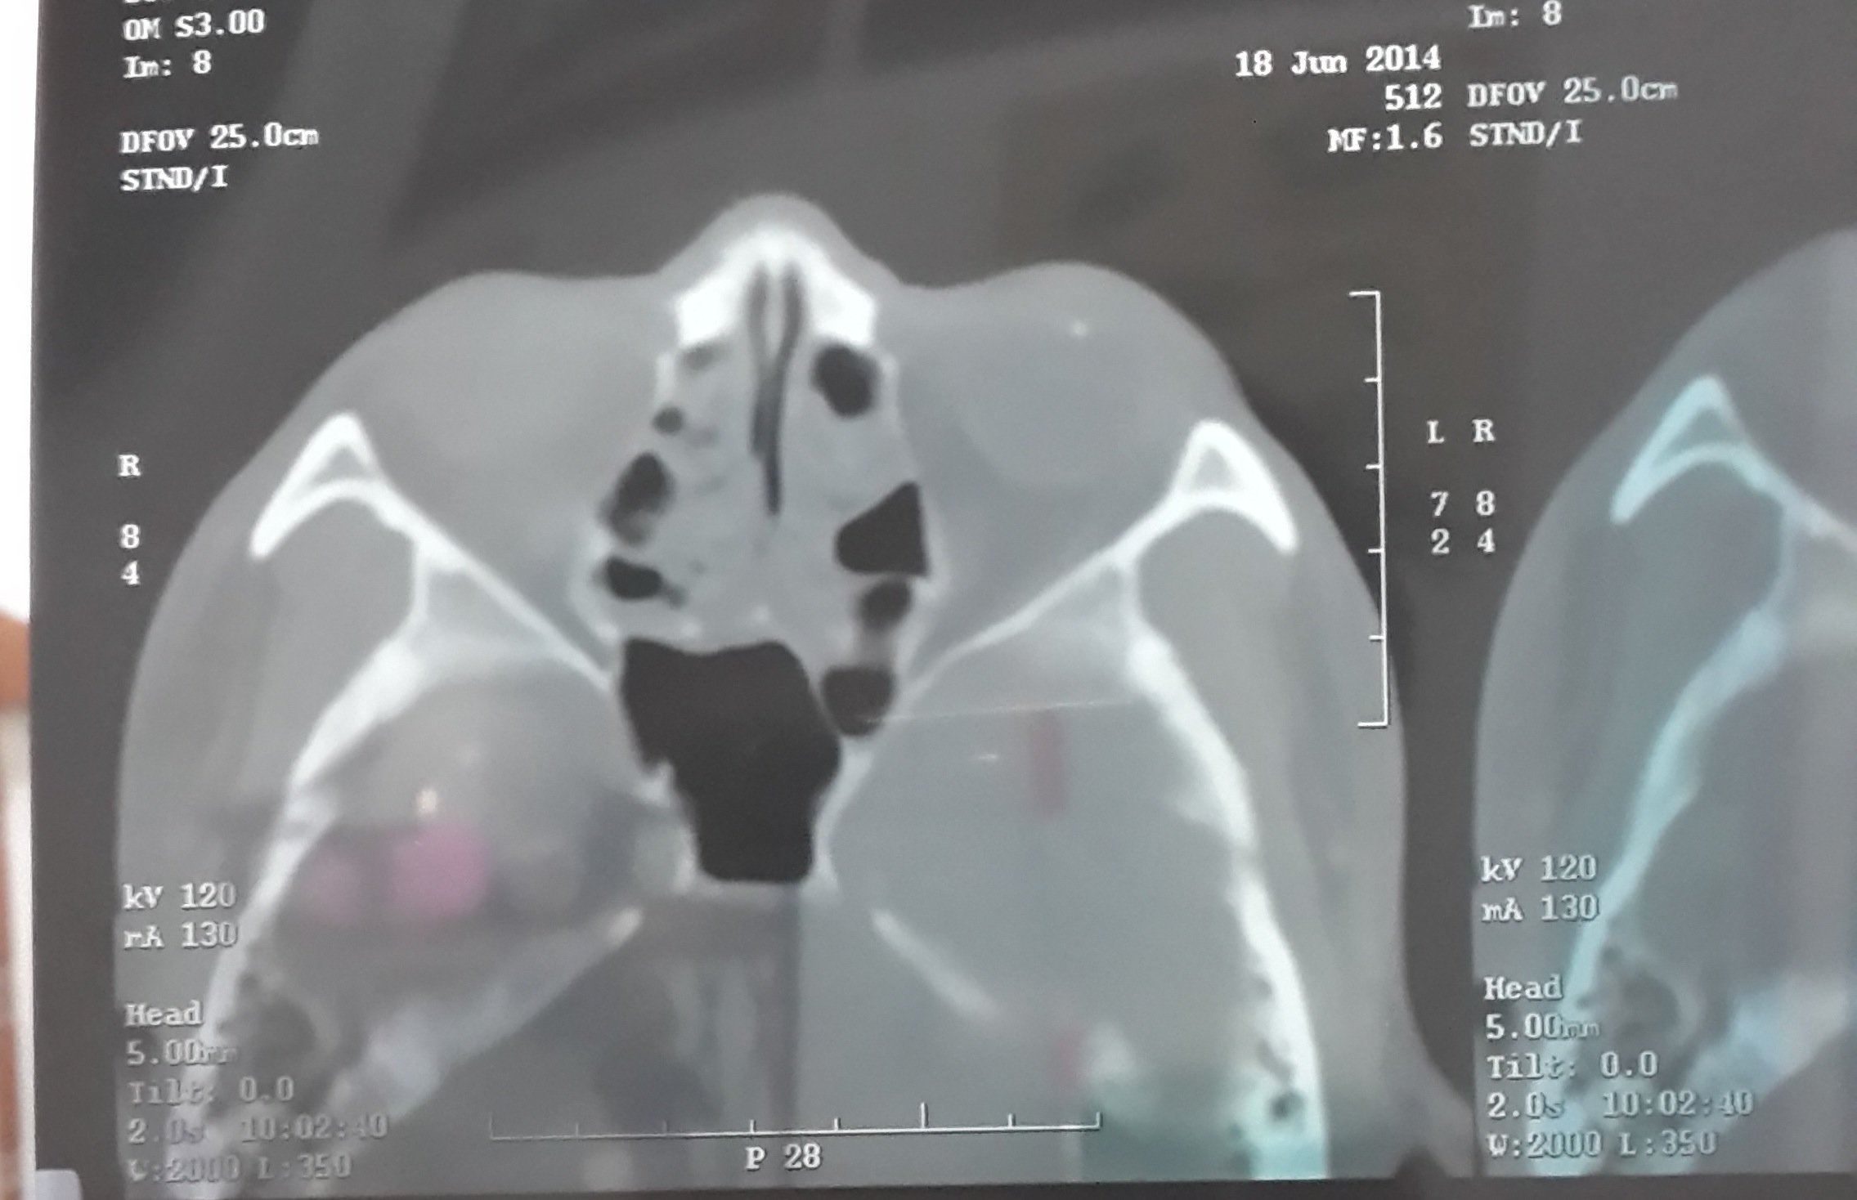
CT scan was done to visualize the FB and to look for any other FB which could be undetected through slit lamp and fundus examination.

Slide 6
Considerations
    Are you going to remove the cataract and meanwhile take out the FB immediately?
    Can we just wait
      till the inflammation subsides
      If we do, how long should you wait and what should you do?

Slide 7

When a metallic FB is in the eye, what do you worry about?
    Siderosis Bulbi

Slide 8
What is siderosis bulbi?
    Siderosis bulbi is a pigmentary and degenerative change in the eye that follows intraocular retention of a foreign body containing iron.
    Take home message
      Siderosis bulbi results from undetected metallic IOFB.

Slide 9
Is it catastrophic?
  Yes.
    Chronic inflammation
    Iris heterochromia
    Dilated pupil
    Glaucoma
    Cataract formation with brownish deposits on lens capsule
    Retinal degenerative disease (an RP-like) ➔ night blindness
    Optic disc swelling

Slide 10
Siderosis can be either chemically or clinically staged.
    Chemically, siderosis is divided into 2 stages
      Corrosion: chemical damage of iron
      Diffusion and precipitation or iron

Slide 11

Clinical Classification
Latent phase
Spread of iron and epithelial stain
Tissue degeneration resulting from toxic effect of iron
Retained metallic IOFB

Slide 12
Results of iron precipitation in 20 enucleated siderotic eyes

Slide 13
Development of Siderosis
How long will siderosis develop?
  It depends…
    From weeks to many years
      (a) The shape, size, and corrosive properties of the foreign body;
      (b) The site of the foreign body
      (c) The associated trauma and resulting tissue reaction.

Slide 14
Corrosive properties
Corrosion: the damage caused by chemical reaction
    The more magnetic, the more corrodible.
      Alloy: all are magnetic
      Stainless steel
        Magnetic
        Non magnetic
      Tool: all are magnetic
      Manganese: non-magnetic

Slide 15
Considerations
    Are you going to remove the cataract and meanwhile take out the FB immediately?
    Can we just wait
      till the inflammation subsides
      If we do, how long should you wait and what should you do?

Slide 16
It depends…

Slide 17


Slide 18
A retained metallic IOFB, regardless of how long, can be successfully managed by just removing the FB when presented or detected.
  Is siderosis treatable?
    Yes
    Brit. J. Ophthal. (1954) 38, 727

Slide 19
References
    Brit. J. Ophthal. (1954) 38, 727
    J Chin Med Assoc 2009;72(1):42–44
    Clinical Ophthalmology 2010:4 955–957
    Int J Ophthalmol 2011;4(3): 326-328
    J Ophthal Inflamm Infect (2011) 1:85–87
    Korean Journal of Ophthalmology 2008;22:272-275
    Indian J Ophthalmol. Jan 2013; 61(1): 30-32

Slide 20


Slide 21
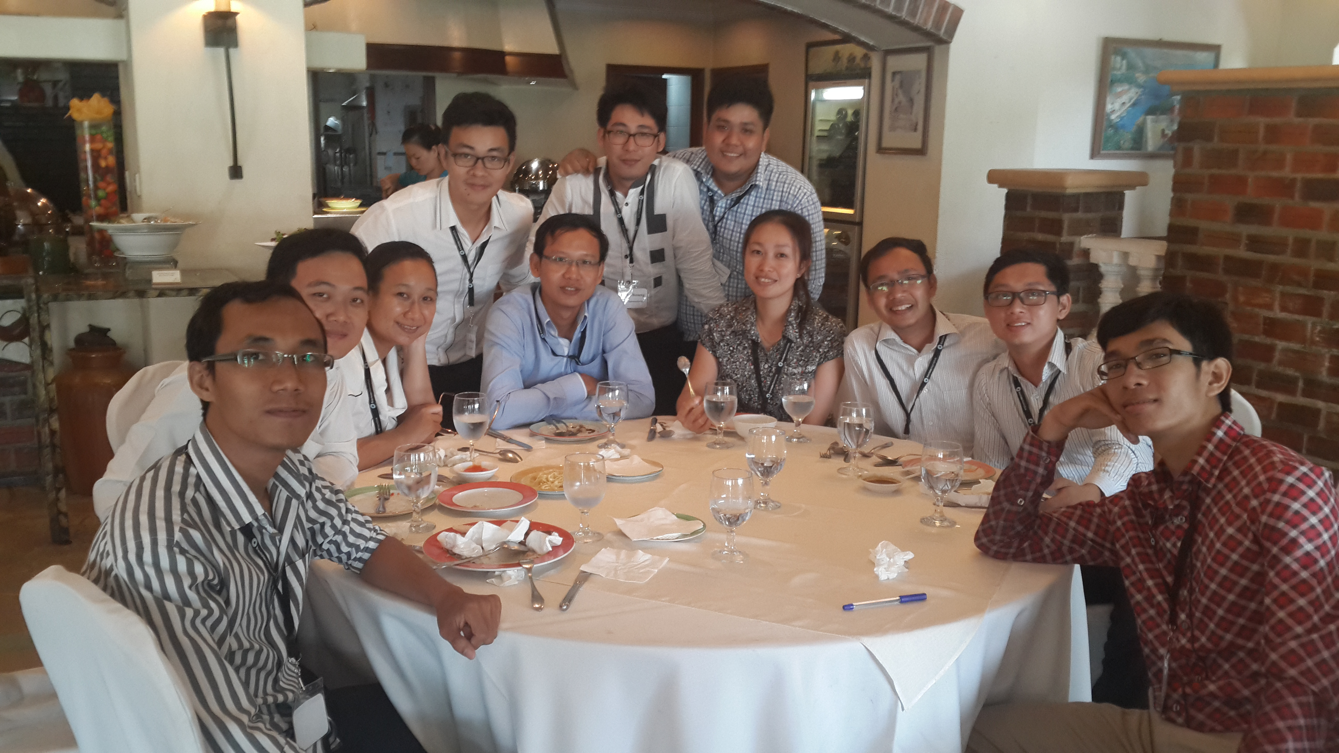
Your Commitment Brings Success.

